Slide 2
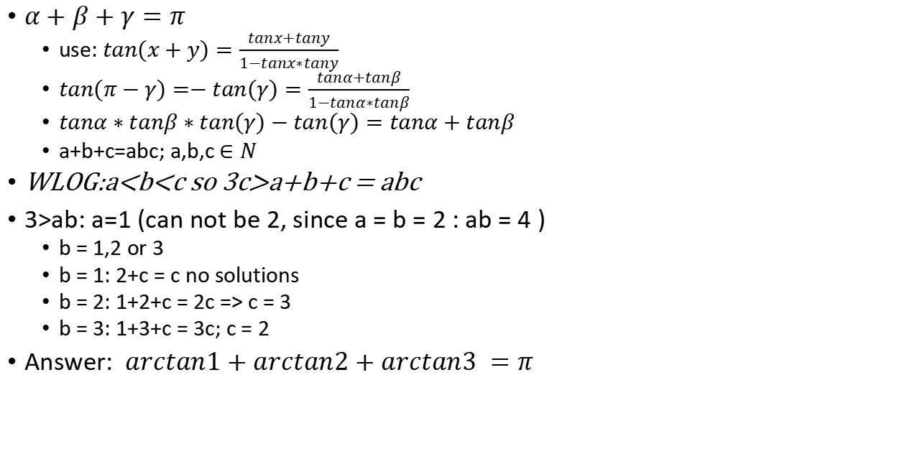
$$α,β,γ is a triangle, tanα,tanβ,tanγ ∈N$$
$α+β+γ=π$
use: $tan(x+y)=\frac{tanx+tany}{1−tanx∗tany}$
$tan(π−γ)=−tan(γ)=\frac{tanα+tanβ}{1−tanα∗tanβ}$
$tanα∗tanβ∗tan(γ)−tan(γ)=tanα+tanβ$
a+b+c=abc; a,b,c $∈N$
WLOG:a<b<c so 3c>a+b+c = abc
3>ab: a=1 (can not be 2, since a = b = 2 : ab = 4 )
b = 1,2 or 3
b = 1: 2+c = c no solutions
b = 2: 1+2+c = 2c => c = 3
b = 3: 1+3+c = 3c; c = 2
Answer: $arctan1+arctan2+arctan3 =π$

Slide 3
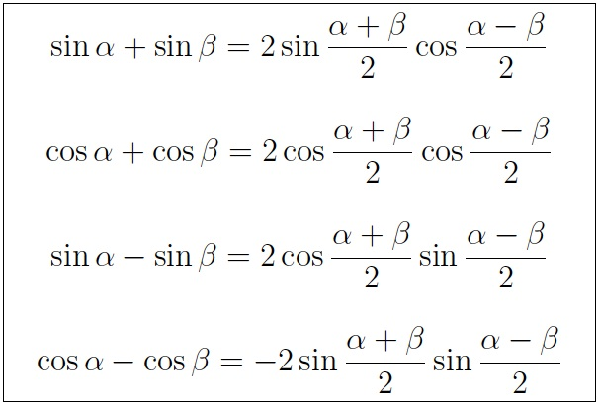
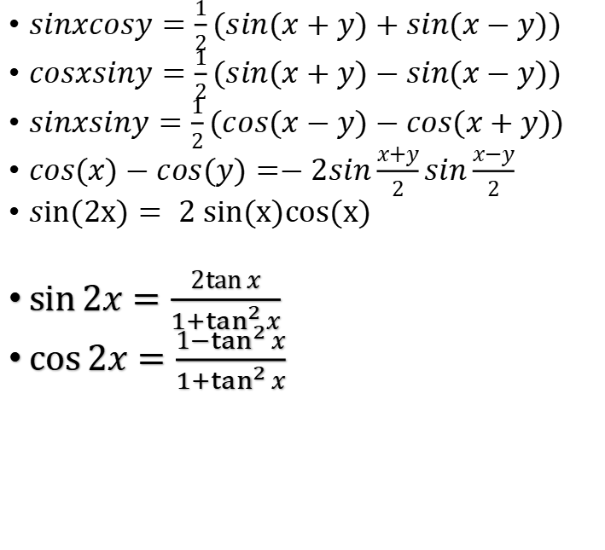
Trig formulas:
$sinxcosy=\frac{1}{2}(sin(x+y)+sin(x−y))$
$cosxsiny=\frac{1}{2}(sin(x+y)−sin(x−y))$
$sinxsiny=\frac{1}{2}(cos(x−y)−cos(x+y))$
$cos(x)−cos(y)=−2sin\frac{x+y}{2}sin\frac{x−y}{2}$
$sin(2x)= 2 sin(x)cos(x)$
$\sin{2x}=\frac{2\tan{x}}{{1+tan}^{2}{x}}$
$\cos{2x}=\frac{1−\tan^{2}{x}}{{1+tan}^{2}{x}}$

Slide 4

Arc-trig formulas:
$arctan($x)-arctan(y)=$arctan(\frac{x−y}{1+xy})$
$arctan(n+1)−arctan(n)=arctan(\frac{1}{n^{2}+n+1})$
sin(arctan(x))=$\frac{1}{\sqrt{1+x^{2}}}$

Slide 5
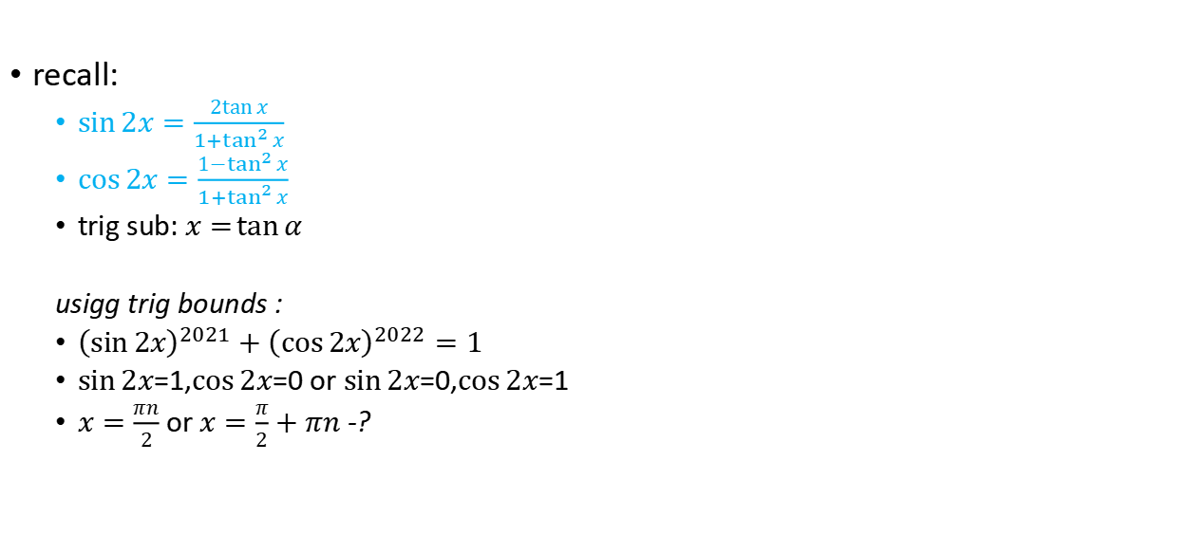

$${\left(\frac{2x}{1+x^{2}}\right)}^{2021}+{\left(\frac{1−x^{2}}{1+x^{2}}\right)}^{2022}=1$$
recall:
$\sin{2x}=\frac{2\tan{x}}{{1+tan}^{2}{x}}$
$\cos{2x}=\frac{1−\tan^{2}{x}}{{1+tan}^{2}{x}}$
trig sub: $x=\tan{α}$
usigg trig bounds :
${\left(\sin{2x}\right)}^{2021}+{\left(\cos{2x}\right)}^{2022}=1$
$\sin{2x}$=1,$\cos{2x}$=0 or $\sin{2x}$=0,$\cos{2x}$=1
$x=\frac{πn}{2}$ or $x=\frac{π}{2}+πn$ -?

Slide 6


Slide 7
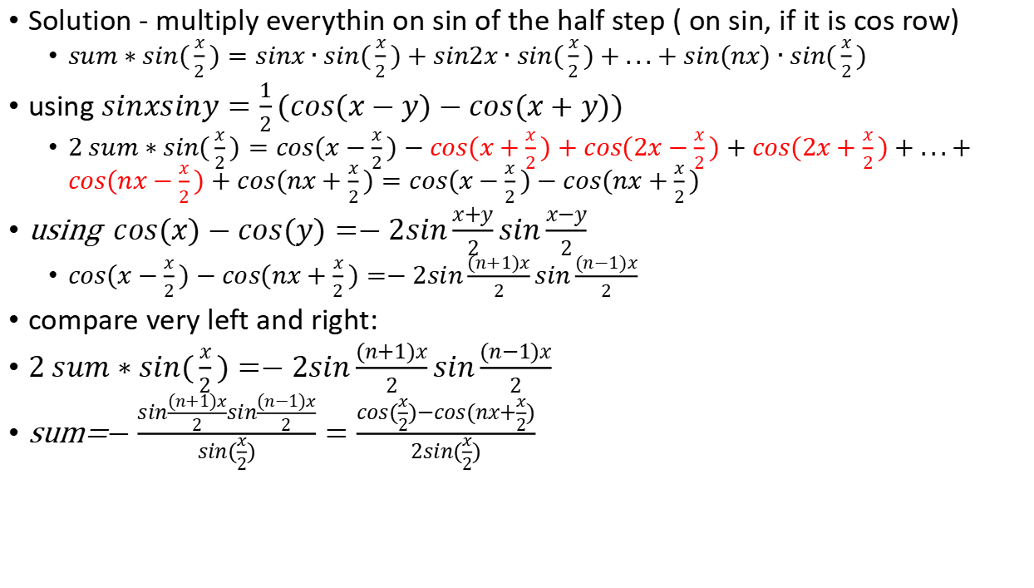
$$sinx+sin2x+...+sin(nx) =sum−?; half step$$
Solution - multiply everythin on sin of the half step ( on sin, if it is cos row)
$sum∗sin(\frac{x}{2})=sinx∙sin(\frac{x}{2})+sin2x∙sin(\frac{x}{2})+...+sin(nx)∙sin(\frac{x}{2})$
using $sinxsiny=\frac{1}{2}(cos(x−y)−cos(x+y))$
2 $sum∗sin(\frac{x}{2})=cos(x−\frac{x}{2})−cos(x+\frac{x}{2})+cos(2x−\frac{x}{2})+cos(2x+\frac{x}{2})+...+cos(nx−\frac{x}{2})+cos(nx+\frac{x}{2})=cos(x−\frac{x}{2})−cos(nx+\frac{x}{2})$
using $cos(x)−cos(y)=−2sin\frac{x+y}{2}sin\frac{x−y}{2}$
$cos(x−\frac{x}{2})−cos(nx+\frac{x}{2})=−2sin\frac{(n+1)x}{2}sin\frac{(n−1)x}{2}$
compare very left and right:
2 $sum∗sin(\frac{x}{2})=−2sin\frac{(n+1)x}{2}sin\frac{(n−1)x}{2}$
sum=$−\frac{sin\frac{(n+1)x}{2}sin\frac{(n−1)x}{2}}{sin(\frac{x}{2})}=\frac{cos(\frac{x}{2})−cos(nx+\frac{x}{2})}{2sin(\frac{x}{2})}$

Slide 8
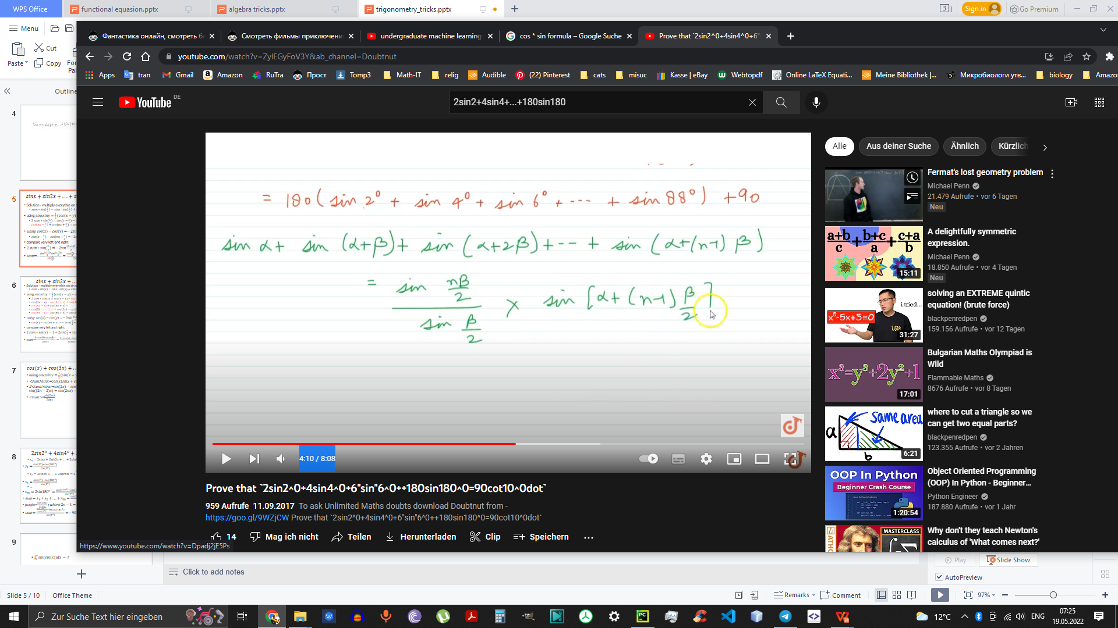
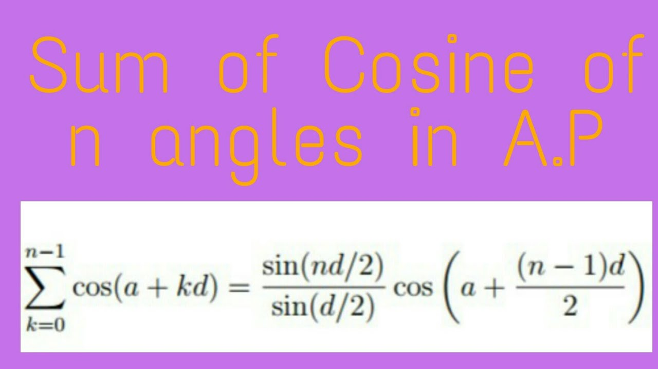

Slide 9
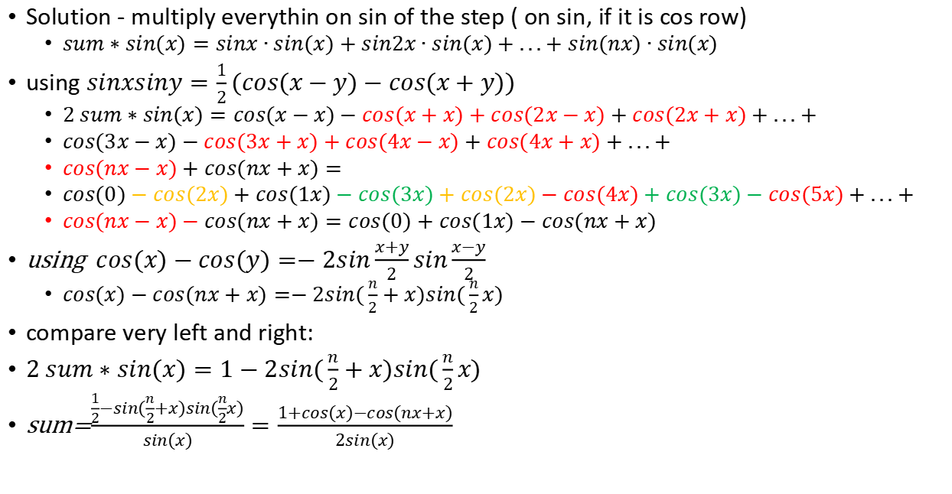
$$sinx+sin2x+...+sin(nx) =sum; full step$$
Solution - multiply everythin on sin of the step ( on sin, if it is cos row)
$sum∗sin(x)=sinx∙sin(x)+sin2x∙sin(x)+...+sin(nx)∙sin(x)$
using $sinxsiny=\frac{1}{2}(cos(x−y)−cos(x+y))$
2 $sum∗sin(x)=cos(x−x)−cos(x+x)+cos(2x−x)+cos(2x+x)+...+$
$cos(3x−x)−cos(3x+x)+cos(4x−x)+cos(4x+x)+...+$
$cos(nx−x)+cos(nx+x)=$
$cos(0)−cos(2x)+cos(1x)−cos(3x)+cos(2x)−cos(4x)+cos(3x)−cos(5x)+...+$
$cos(nx−x)−cos(nx+x)=cos(0)+cos(1x)−cos(nx+x)$
using $cos(x)−cos(y)=−2sin\frac{x+y}{2}sin\frac{x−y}{2}$
$cos(x)−cos(nx+x)=−2sin(\frac{n}{2}+x)sin(\frac{n}{2}x)$
compare very left and right:
2 $sum∗sin(x)=1−2sin(\frac{n}{2}+x)sin(\frac{n}{2}x)$
sum=$\frac{\frac{1}{2}−sin(\frac{n}{2}+x)sin(\frac{n}{2}x)}{sin(x)}=\frac{1+cos(x)−cos(nx+x)}{2sin(x)}$

Slide 10

$$cos(x)+cos(3x)+...+cos((2n−1)x);n≥1$$
using $cosxsiny=\frac{1}{2}(sin(x+y)−sin(x−y))$
<sum>$sinx$=$cos(x)sinx+cos(3x)sinx+...+cos((2n−1)x)sinx$
2<sum>$sinx$=$sin(2x)−sin(0)+sin(4x)−sin(2x)+...+sin(2nx)−sin((2n−2)x)=sin(2nx)−sin(0)=sin(2nx)$
<sum>=$\frac{sin(2nx)}{2sinx}$

Slide 11
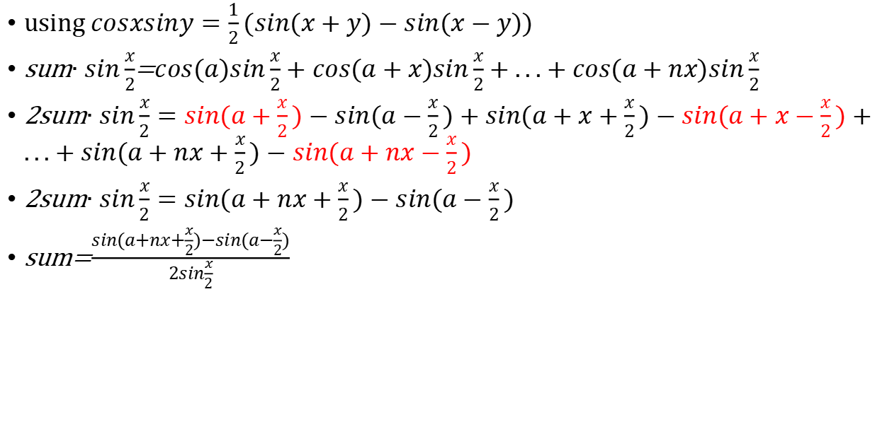
$$cos(a)+cos(a+x)+...+cos(a+nx);$$
using $cosxsiny=\frac{1}{2}(sin(x+y)−sin(x−y))$
sum$∙sin\frac{x}{2}$=$cos(a)sin\frac{x}{2}+cos(a+x)sin\frac{x}{2}+...+cos(a+nx)sin\frac{x}{2}$
2sum$∙sin\frac{x}{2}=sin(a+\frac{x}{2})−sin(a−\frac{x}{2})+sin(a+x+\frac{x}{2})−sin(a+x−\frac{x}{2})+...+sin(a+nx+\frac{x}{2})−sin(a+nx−\frac{x}{2})$
2sum$∙sin\frac{x}{2}=sin(a+nx+\frac{x}{2})−sin(a−\frac{x}{2})$
sum=$\frac{sin(a+nx+\frac{x}{2})−sin(a−\frac{x}{2})}{2sin\frac{x}{2}}$

Slide 12
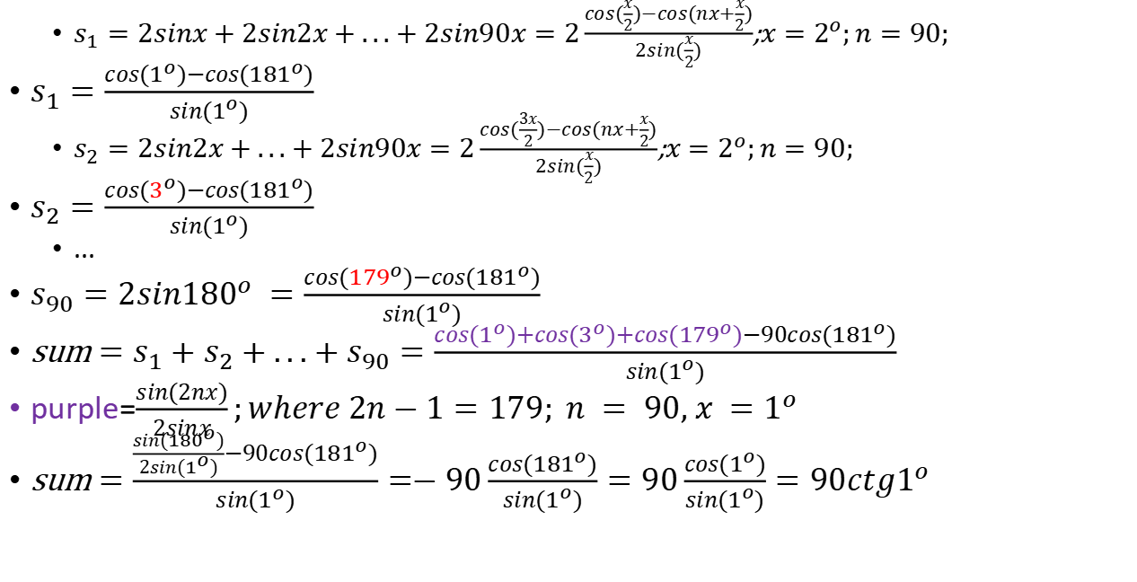
$$2sin2^{o}+4sin4^{o}+...+180sin{180}^{o} =sum−?$$
$s_{1}=2sinx+2sin2x+...+2sin90x=2\frac{cos(\frac{x}{2})−cos(nx+\frac{x}{2})}{2sin(\frac{x}{2})}$;$x=2^{o};n=90;$
$s_{1}=\frac{cos(1^{o})−cos({181}^{o})}{sin(1^{o})}$
$s_{2}=2sin2x+...+2sin90x=2\frac{cos(\frac{3x}{2})−cos(nx+\frac{x}{2})}{2sin(\frac{x}{2})}$;$x=2^{o};n=90;$
$s_{2}=\frac{cos(3^{o})−cos({181}^{o})}{sin(1^{o})}$
...
$s_{90}=2sin{180}^{o} =\frac{cos({179}^{o})−cos({181}^{o})}{sin(1^{o})}$
sum $=s_{1}+s_{2}+...+s_{90}=\frac{cos(1^{o})+cos(3^{o})+cos({179}^{o})−90cos({181}^{o})}{sin(1^{o})}$
purple=$\frac{sin(2nx)}{2sinx};where 2n−1=179; n = 90, x =1^{o}$
sum $=\frac{\frac{sin({180}^{o})}{2sin(1^{o})}−90cos({181}^{o})}{sin(1^{o})}=−90\frac{cos({181}^{o})}{sin(1^{o})}=90\frac{cos(1^{o})}{sin(1^{o})}=90ctg1^{o}$

Slide 13
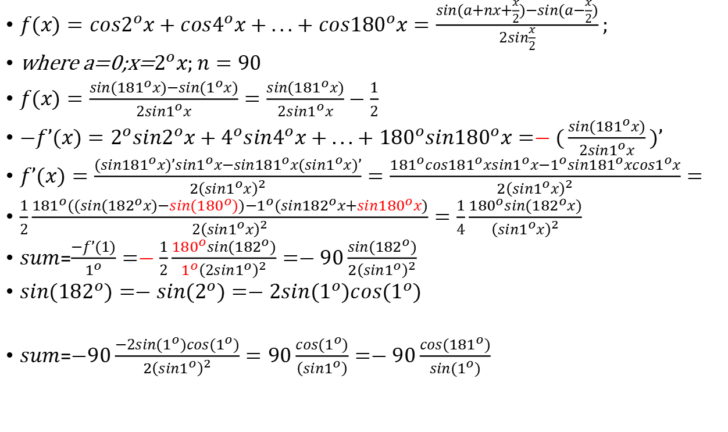
$$2sin2^{o}+4sin4^{o}+...+180sin{180}^{o} =sum;dif$$
$f(x)=cos2^{o}x+cos4^{o}x+...+cos{180}^{o}x=\frac{sin(a+nx+\frac{x}{2})−sin(a−\frac{x}{2})}{2sin\frac{x}{2}};$
where a=0;x=$2^{o}x;n=90$
$f(x)=\frac{sin({181}^{o}x)−sin(1^{o}x)}{2sin1^{o}x}=\frac{sin({181}^{o}x)}{2sin1^{o}x}−\frac{1}{2}$
$−f’(x)=2^{o}sin2^{o}x+4^{o}sin4^{o}x+...+{180}^{o}sin{180}^{o}x=−(\frac{sin({181}^{o}x)}{2sin1^{o}x})’$
$f’(x)=\frac{(sin{181}^{o}x)’sin1^{o}x−sin{181}^{o}x(sin1^{o}x)’}{{2\left(sin1^{o}x\right)}^{2}}=\frac{{181}^{o}cos{181}^{o}xsin1^{o}x−1^{o}sin{181}^{o}xcos1^{o}x}{{2\left(sin1^{o}x\right)}^{2}}=$
$\frac{1}{2}\frac{{181}^{o}((sin({182}^{o}x)−sin({180}^{o}))−1^{o}(sin{182}^{o}x+sin{180}^{o}x)}{2{\left(sin1^{o}x\right)}^{2}}=\frac{1}{4}\frac{{180}^{o}sin({182}^{o}x)}{{\left(sin1^{o}x\right)}^{2}}$
$sum$=$\frac{−f’(1)}{1^{o}}=−\frac{1}{2}\frac{{180}^{o}sin({182}^{o})}{{1^{o}\left(2sin1^{o}\right)}^{2}}=−90\frac{sin({182}^{o})}{{2\left(sin1^{o}\right)}^{2}}$
$sin({182}^{o})=−sin(2^{o})=−2sin(1^{o})cos(1^{o})$
$sum$=$−90\frac{−2sin(1^{o})cos(1^{o})}{{2\left(sin1^{o}\right)}^{2}}=90\frac{cos(1^{o})}{\left(sin1^{o}\right)}=−90\frac{cos({181}^{o})}{sin(1^{o})}$

Slide 14
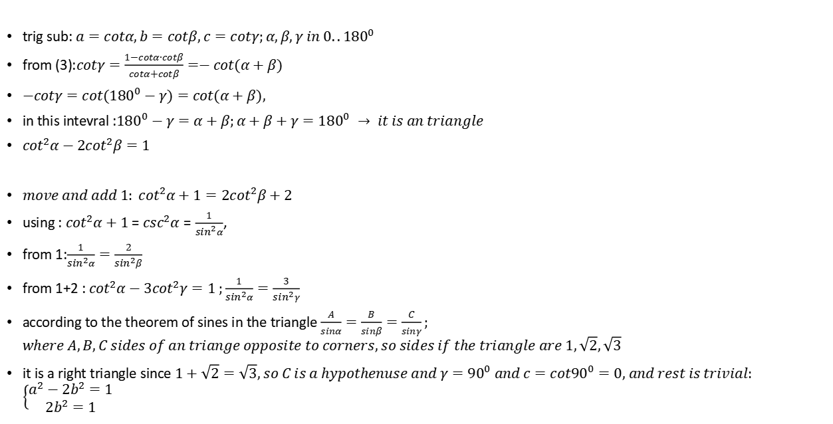
trig sub into system of equasions $\left\{\begin{matrix}a^{2}−2b^{2}=1 ; (1) \\ {2b}^{2}−3c^{2}=1 ; (2) \\ ab+ac+bc=1 ; (3)\end{matrix}\right.$
trig sub: $a=cotα,b=cotβ, c=cotγ;α,β,γ in 0..{180}^{0}$
from (3):$cotγ=\frac{1−cotα∙cotβ}{cotα+cotβ}=−cot(α+β)$
$−cotγ=cot({180}^{0}−γ)=cot(α+β),$
in this intevral :${180}^{0}−γ=α+β;α+β+γ={180}^{0} → it is an triangle$
$\cot^{2}α−2\cot^{2}β=1$
$move and add 1: \cot^{2}α+1=2\cot^{2}β+2$
using : $\cot^{2}α+1$ = $\csc^{2}α=\frac{1}{\sin^{2}α}$,
from 1:$\frac{1}{\sin^{2}α}=\frac{2}{\sin^{2}β}$
from 1+2 : $\cot^{2}α−3\cot^{2}γ=1 ;\frac{1}{\sin^{2}α}=\frac{3}{\sin^{2}γ}$
according to the theorem of sines in the triangle $\frac{A}{sinα}=\frac{B}{sinβ}=\frac{C}{sinγ};$ $where A,B,C sides of an triange opposite to corners, so sides if the triangle are 1,\sqrt{2},\sqrt{3}$
it is a right triangle since $1+\sqrt{2}=\sqrt{3}, so C is a hypothenuse and γ={90}^{0} and c=cot{90}^{0}=0, and rest is trivial:$ $\left\{\begin{matrix}a^{2}−2b^{2}=1 \\ 2b^{2}=1 \end{matrix}\right.$

Slide 15


$$\int_{0}^{a}{sin(sin(x))dx − ?}$$
$sin(x)$=t
x=arcsin(t)
dx=$\frac{dt}{\sqrt{1−t^{2}}}$
I=$\int_{0}^{arcsin(a)}{sin(t)\frac{dt}{\sqrt{1−t^{2}}}}$

Slide 16
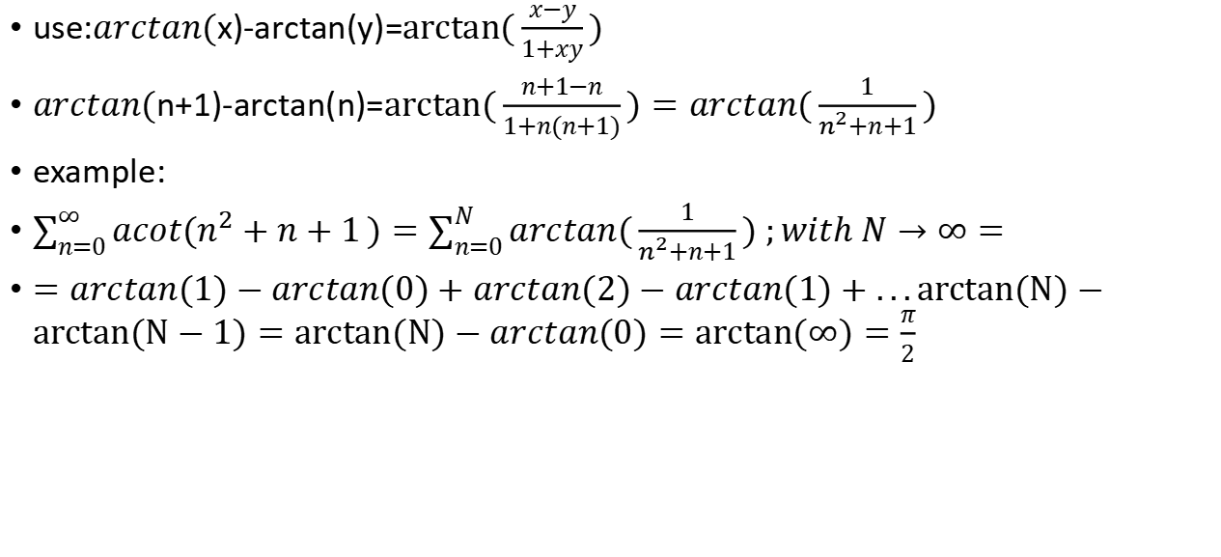
$$arctan(n+1)−arctan(n)=arctan(\frac{1}{n^{2}+n+1})$$
use:$arctan($x)-arctan(y)=$arctan(\frac{x−y}{1+xy})$
$arctan($n+1)-arctan(n)=$arctan(\frac{n+1−n}{1+n(n+1)})=arctan(\frac{1}{n^{2}+n+1})$
example:
$\sum_{n=0}^{∞}{acot(n^{2}+n+1})=\sum_{n=0}^{N}{arctan(\frac{1}{n^{2}+n+1}) ;}with N→∞=$
$=arctan(1)−arctan(0)+arctan(2)−arctan(1)+...arctan(N)−arctan(N−1)=arctan(N)−arctan(0)=arctan(∞)=\frac{π}{2}$

